Slide 1
November 7, 2022
Instacart - Customer Segmentation and Market Basket Analysis
Marketing Analytics Project (Group J)
Shreyansh Agrawal, Praneet Kumar Alamuri, Varun Kausika, Nicole Pham-Nguyen
The University of Texas at Austin

Slide 2


OBJECTIVES AND METHODOLOGY
Problem Statement
E-commerce companies desire to understand customer behavior and trends to tailor their marketing strategy as per customer needs with a goal to increase customer order value and improve experience. To assist Instacart (a US based grocery delivery company), we aim to -
Develop customer segments reflecting purchasing behavior for targeted marketing and anticipating customer behavior
Identify best selling products in each segment and recognize hidden associations to promote cross-selling and upselling
Analysis
Methodology and Objective
Exploratory Data Analysis
Combining multiple data files and cleaning data sets
Exploring the dataset to find high-level insights, drivers for customer behavior and purchasing trends
Customer Segmentation
Leveraging historical orders at a customer level to construct segments that reflect the purchasing behaviour of each customer segment
We are planning to leverage clustering algorithms (K-Means Clustering, PCA)
Market Basket Analysis
Understanding which products are associated with each other i.e if customer adds Product A to cart, how likely/ unlikely will the customer also be interested in buying Product B
We are planning to use metrics such as Support, Confidence and Lift to understand these associations
This information can help in deciding which products should be cross-sold or promoted together

Slide 3
DATA DESCRIPTION
We have 5 files as part of Instacart’s transaction dataset. Below is the high-level description of each file.
S No | File Name | Description
1 | aisles | Contains different aisles and there are total 134 unique aisles
2 | departments | Contains different departments and there are total 21 unique departments
3 | orders | Contains all the orders made by different customers (total 3,421,083 orders by 206,209 users)
4 | products | Contains the list of all products and their aisle as well as departments (49,688 products)
5 | order_products_prior | Gives information about which products were ordered and in which order they were added in the cart. It also tells us that if the product was reordered or not (3,214,874 orders)

Slide 4
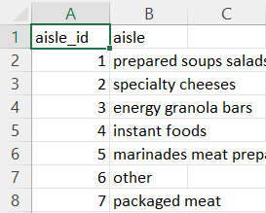
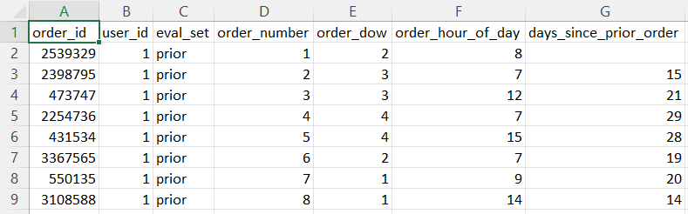
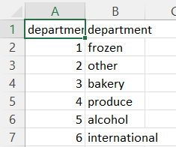
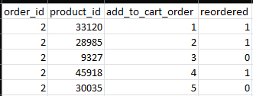
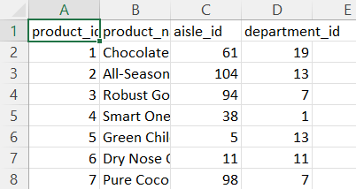
DATA SNAPSHOT
A Quick Look at Some of Our Data
Aisles
Orders
Departments
Order Products Prior
Products

Slide 5
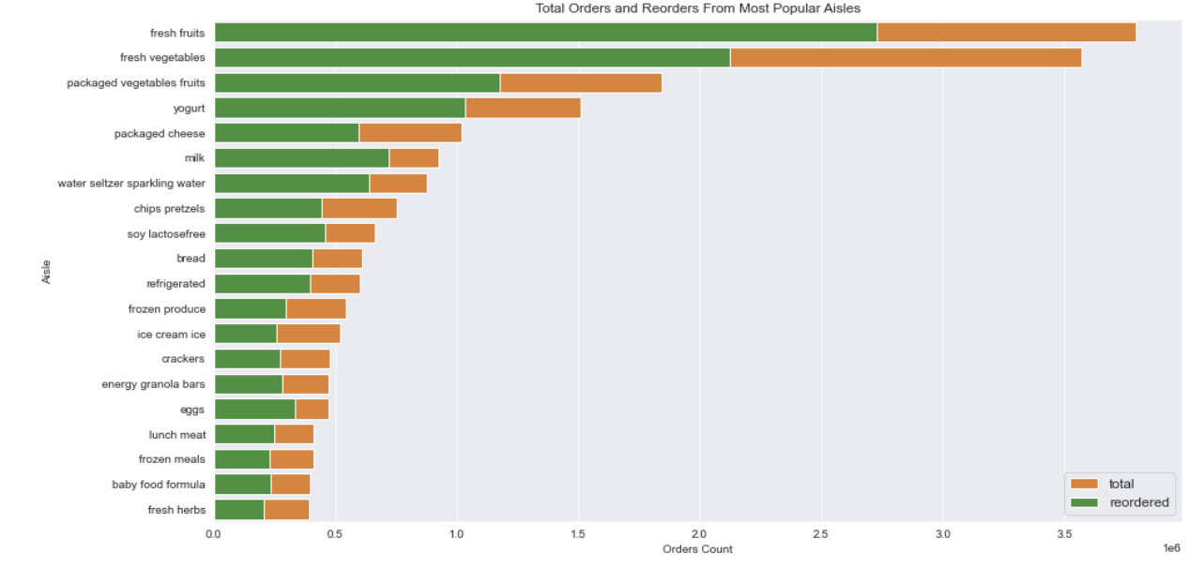
Most orders are from fresh fruits aisle and lowest from fresh herbs; fresh vegetables have the highest reorders

Slide 6
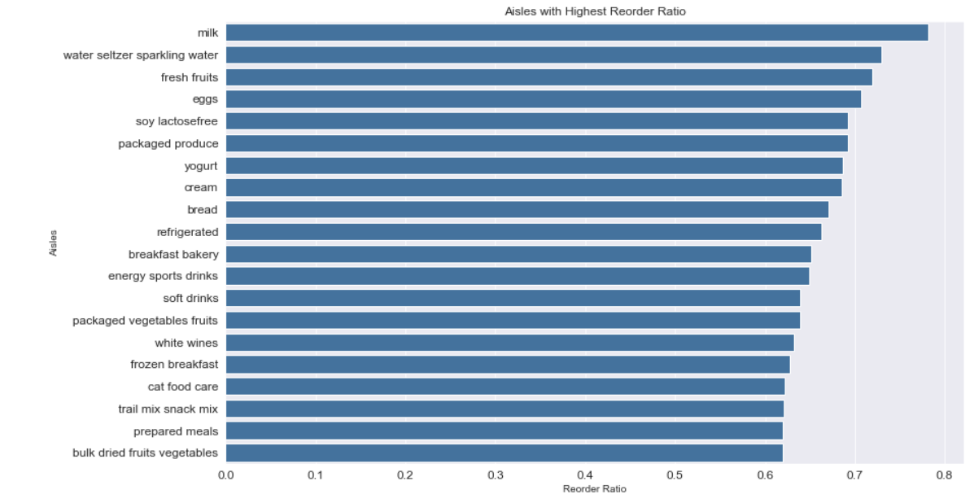
Milk aisle has the highest reorder ratio; remaining top 15 aisles have comparable reorder ratios

Slide 7
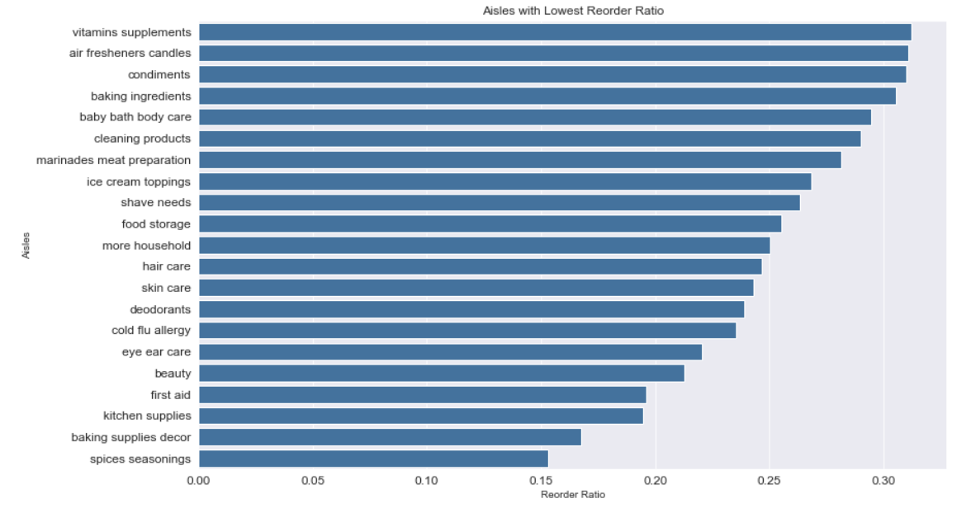
Kitchen supplies, baking supplies decor, and spices seasoning have the lowest reorder ratios

Slide 8
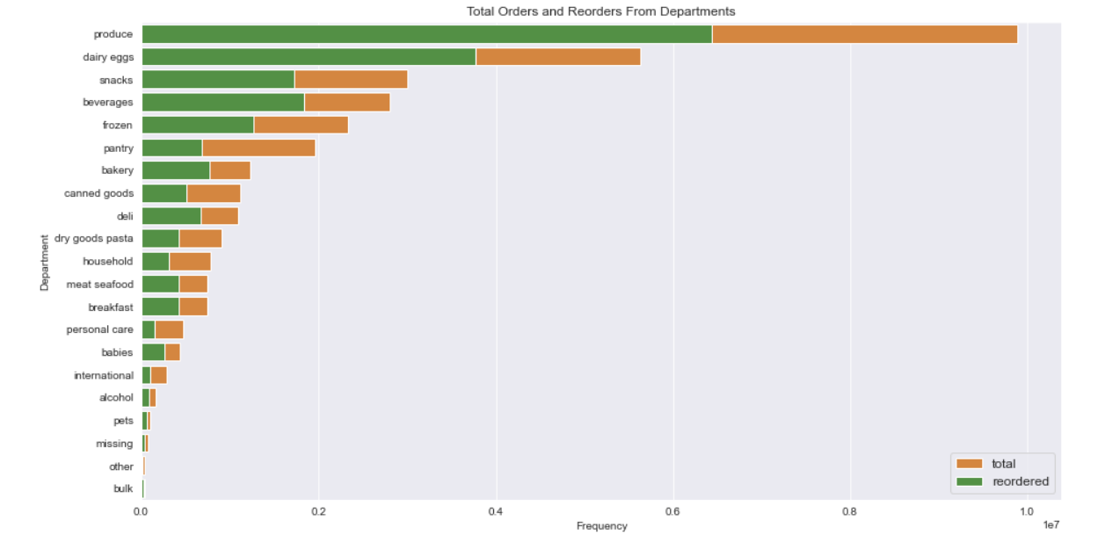
Fresh goods department products like vegetables and dairy items have maximum orders and reorders
Departments with low number of orders were dropped from the segmentation analysis

Slide 9
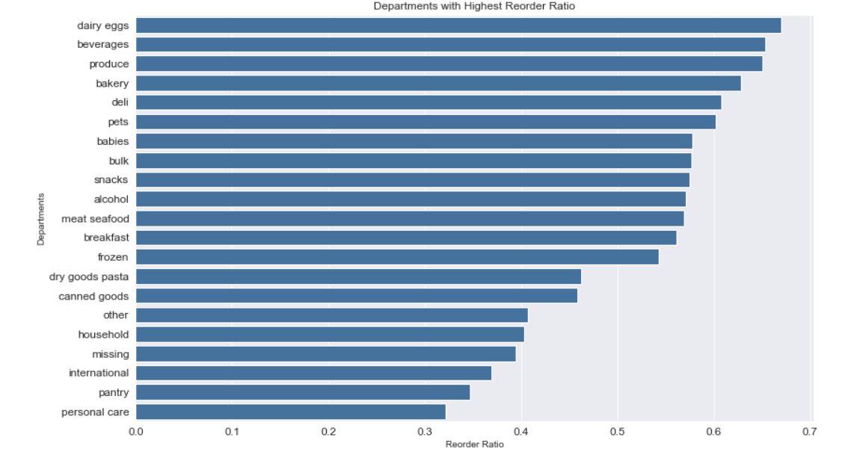
Dairy products and beverages departments have the highest orders and reorders

Slide 10
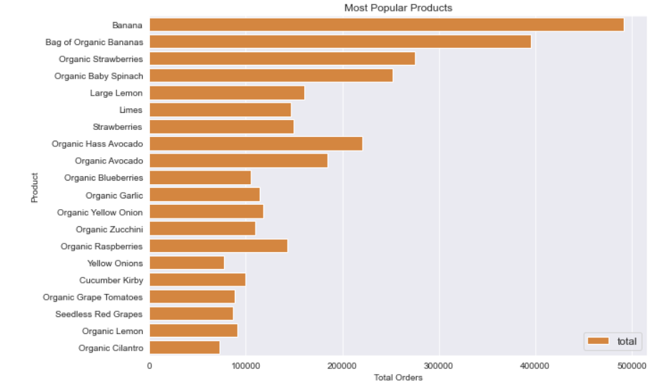
Products with the highest orders can be opportunities to have low selling products to be cross sold with them

Slide 11
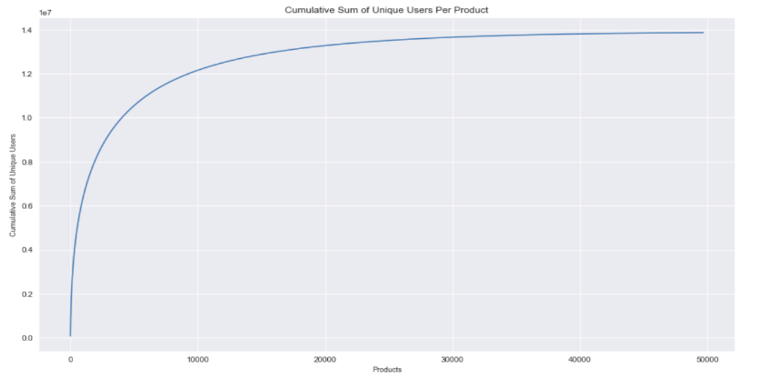
~85% platform users buy only ~10k products
There is an opportunity to cross promote remaining 40k products with low sales to the 85% users to increase sales

Slide 12
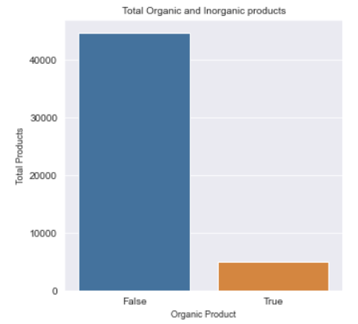
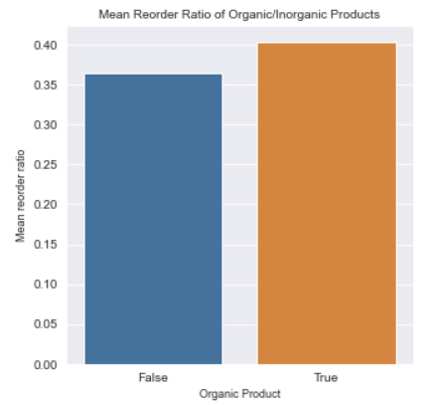
Organic products in spite of low sales have high reorder percentage

Slide 13
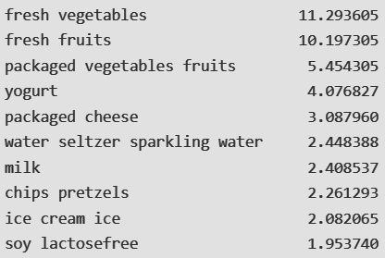
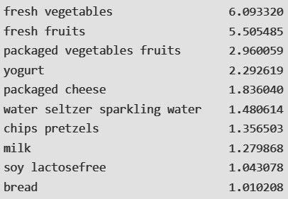
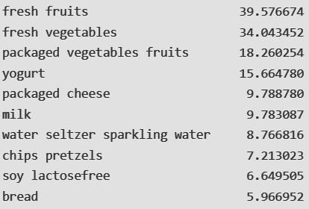
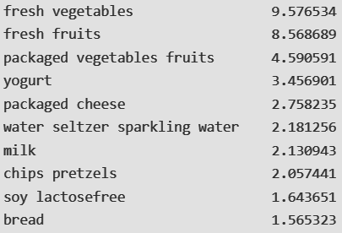
CUSTOMER SEGMENTATION
Not a lot of variability w.r.t the products that each cluster tends to be most associated with
Our segmentation is more indicative of reorders, order hour of day, days since prior order

Slide 14
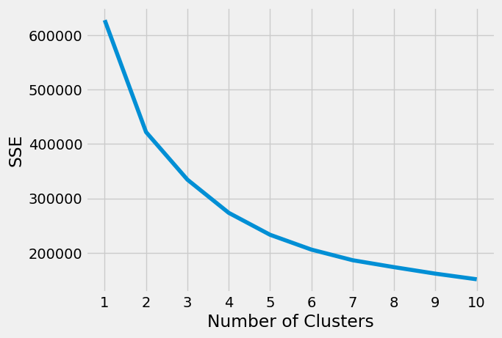
MARKET SEGMENTATION
Details of cluster analysis:
Random initialization
Max iterations: 300
Details of elbow() function:
“Convex” curve
Decreasing trend
k = 4 clusters gave us the best results

Slide 15
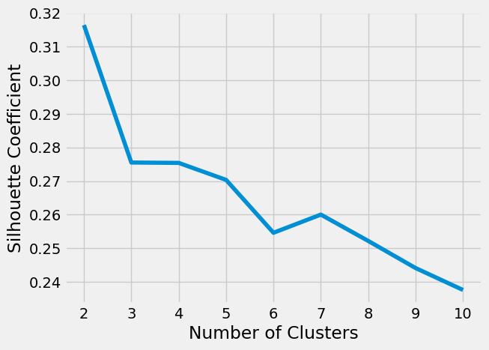
MARKET SEGMENTATION
What are silhouette scores?
Tells us how good the clustering is
Indicates whether a given point is grouped well within it’s cluster and separated enough from the remaining clusters
Ranges from -1 (worst) to 1 (best)
For k = 4, we get a silhouette score of 0.275 (decent)

Slide 16
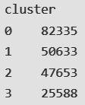
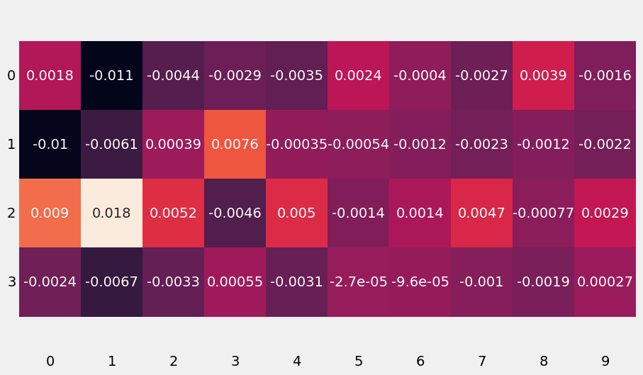
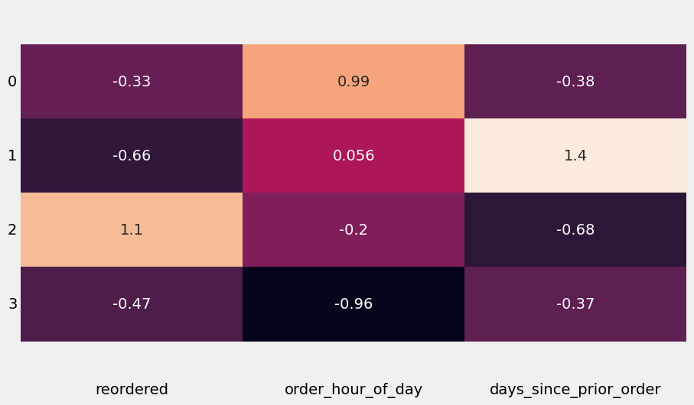
MARKET SEGMENTATION
Number of people in each cluster
Cluster 1 - Orders later in the day
Cluster 2 - High number of days since prior order
Cluster 3 - High number of reorders
Cluster 4 - Orders early in the day
Cluster centroids (for interpretation of clusters)

Slide 17
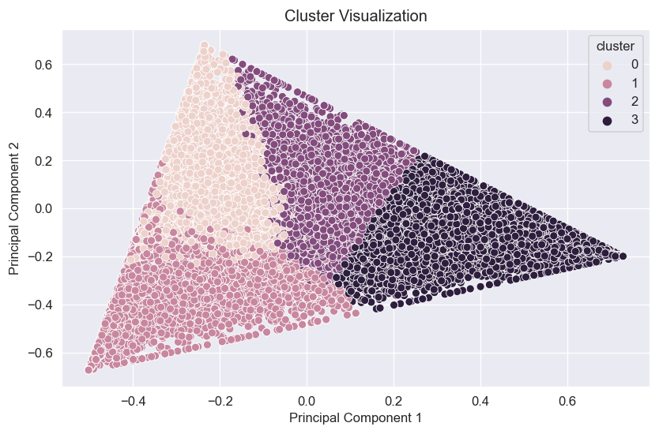
SEGMENTATION BY DEPARTMENT
We have well defined clusters expect we see that there is some overlap b/w clusters 0 and 1
Segments | Segment Description
0 | fresh produce - fruits, vegetables, cheese
1 | beverages and fresh produce - water, soft drinks, tea
2 | packaged produce - fruits, vegetables, frozen produce
3 | fresh produce and cosmetics
Since there are 21 departments, we have projected them in 10 components and performed a k-means clustering with 4 clusters

Slide 18
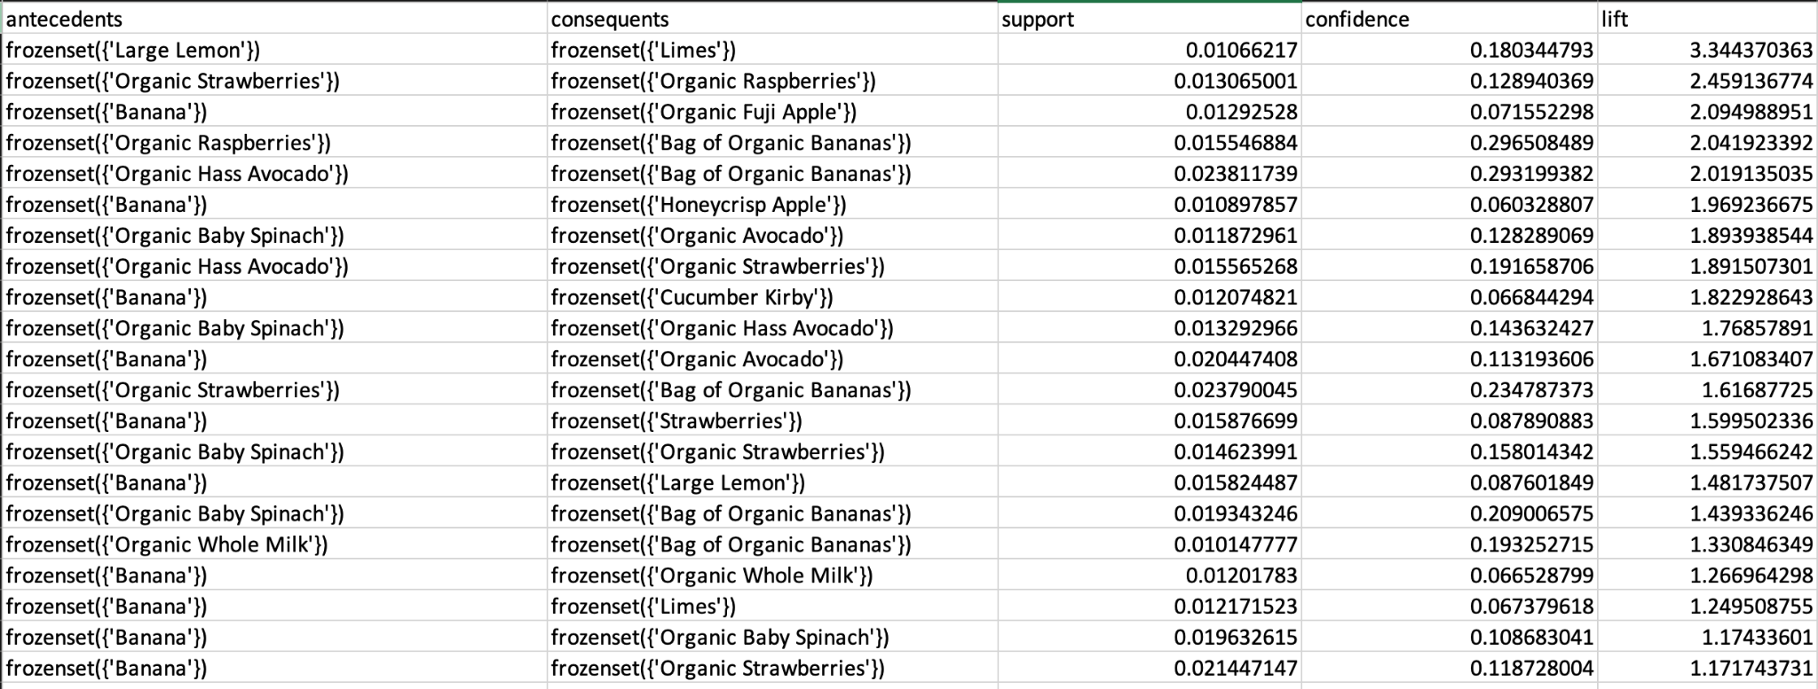
MARKET BASKET ANALYSIS
LIFT ANALYSIS
The most common produce that shows a relationship to other grocery store items is a "banana"
Appeared 10+ times
Generally, all fruit should be grouped together, since they have the highest lift values
All types of produce should be grouped together (citrus fruits, berries)

Slide 19
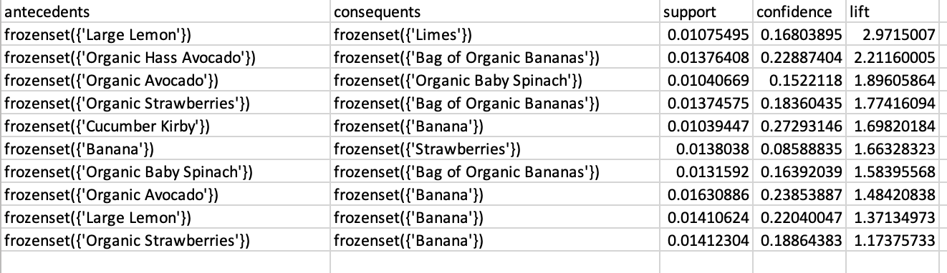
MARKET BASKET ANALYSIS FOR CLUSTER 1

Slide 20
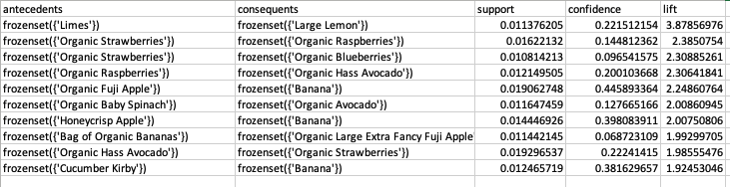
MARKET BASKET ANALYSIS FOR CLUSTER 2

Slide 21
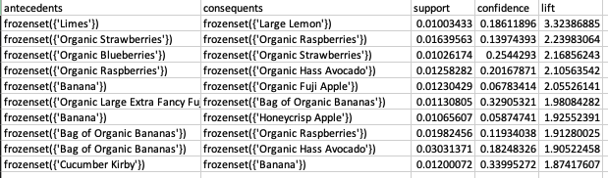
MARKET BASKET ANALYSIS FOR CLUSTER 3

Slide 22
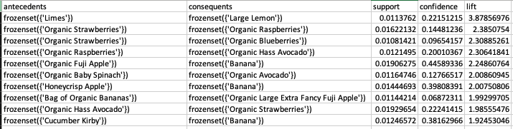
MARKET BASKET ANALYSIS FOR CLUSTER 4

Slide 23
SUMMARY AND CONCLUSION
We segment based on the aisles where customers purchase from, as well as the number of reorders a customer makes, order hour in the day, and days since prior order
We also segmented based on major departments buying habits and the segments showed differences in the purchasing behaviour
We did not see any major differences in the market basket analysis recommendations across segments and hence cross promotion might be difficult

Slide 24
FUTURE SCOPE
Use collaborative filtering to recommend products to users
If data is available, assess profitability of products with low sales to prioritize for cross promotion
For a given user, predict the products that have a scope for reorders and customize promotion
Collect more data and perform further segmentation to see if there is a viable cross-promotion strategy for products
Launch a marketing campaign for products that are bought together somewhat highly, incentivising the lift values to go up for those products as well.

Slide 25
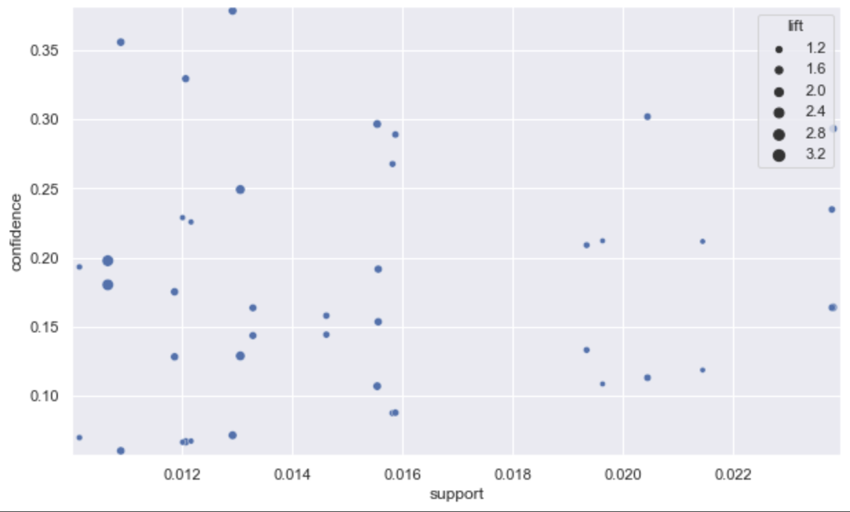
APPENDIX
Appendix A. Scatterplot between Support and Confidence

Slide 26
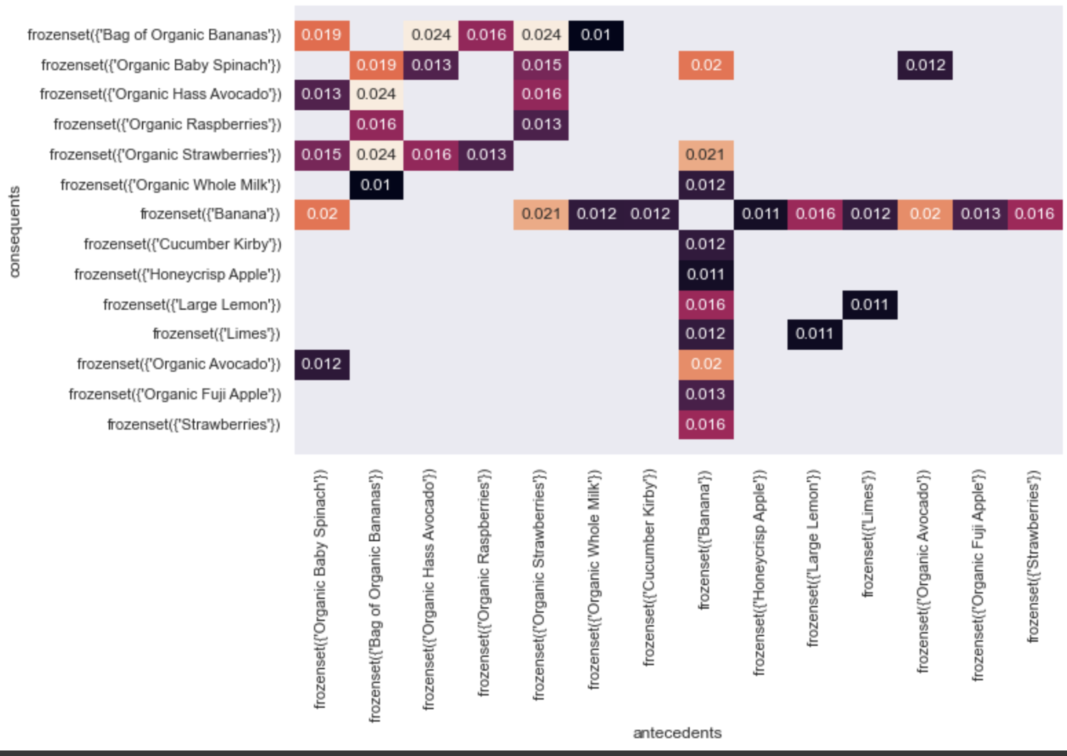
APPENDIX
Appendix B. Heatmap of Support

Slide 27
APPENDIX
Appendix C. Heatmap of Confidence

Slide 28
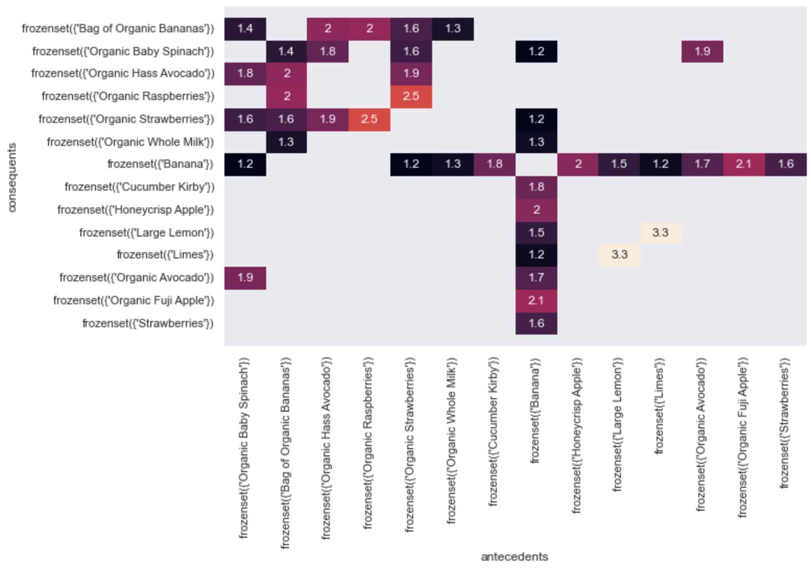
APPENDIX
Appendix D. Heatmap of Lift

Slide 29
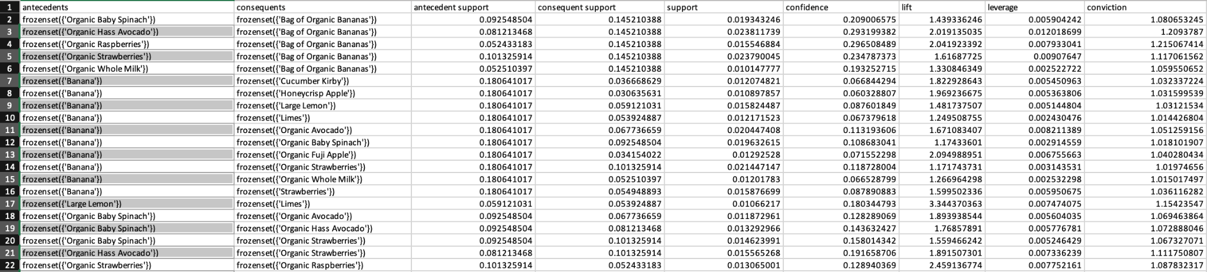
APPENDIX
Appendix E. Full Market Basket Analysis

Slide 30
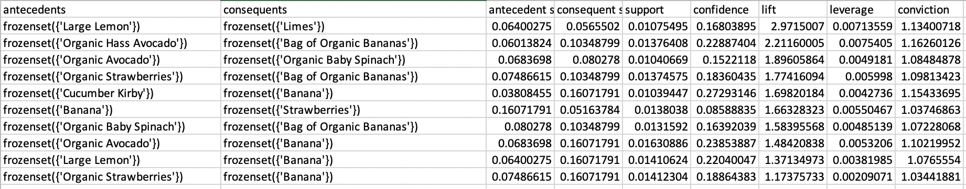
APPENDIX
Appendix F. Market Basket Analysis for Cluster 1

Slide 31
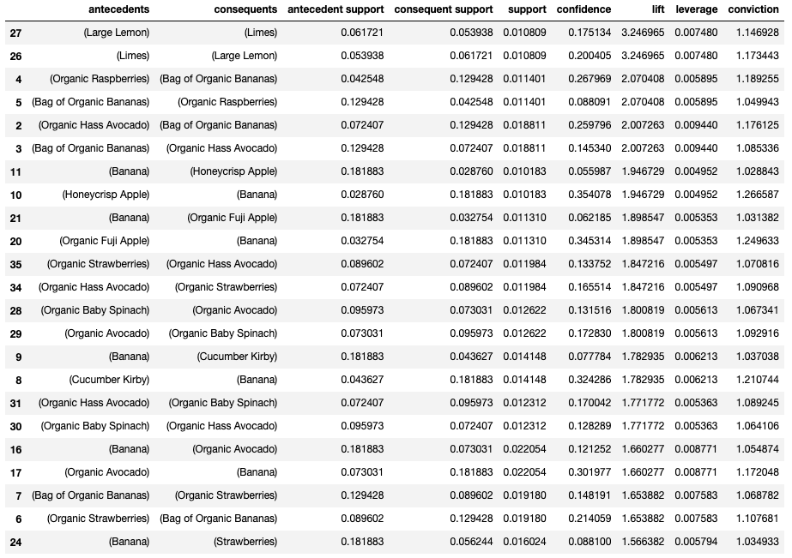
APPENDIX
Appendix G. Market Basket Analysis for Cluster 2

Slide 32
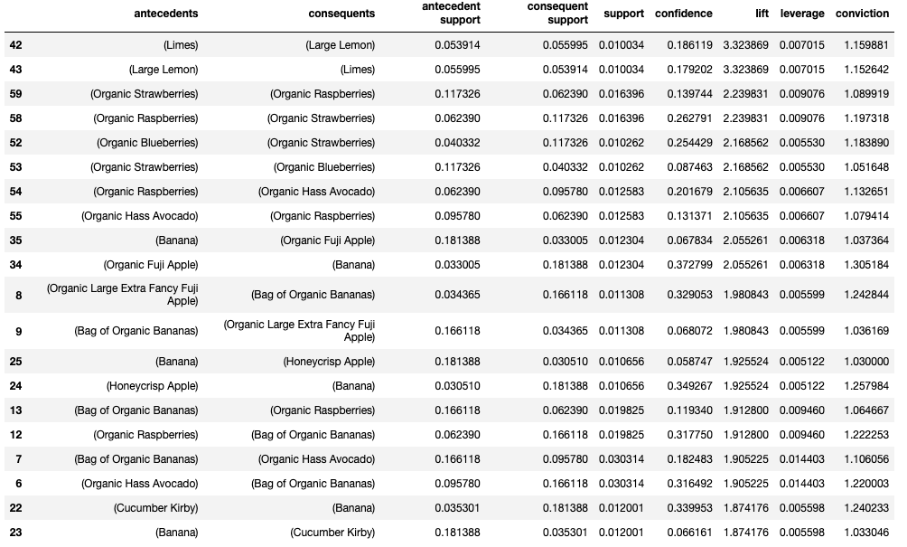
APPENDIX
Appendix H. Market Basket Analysis for Cluster 3

Slide 33
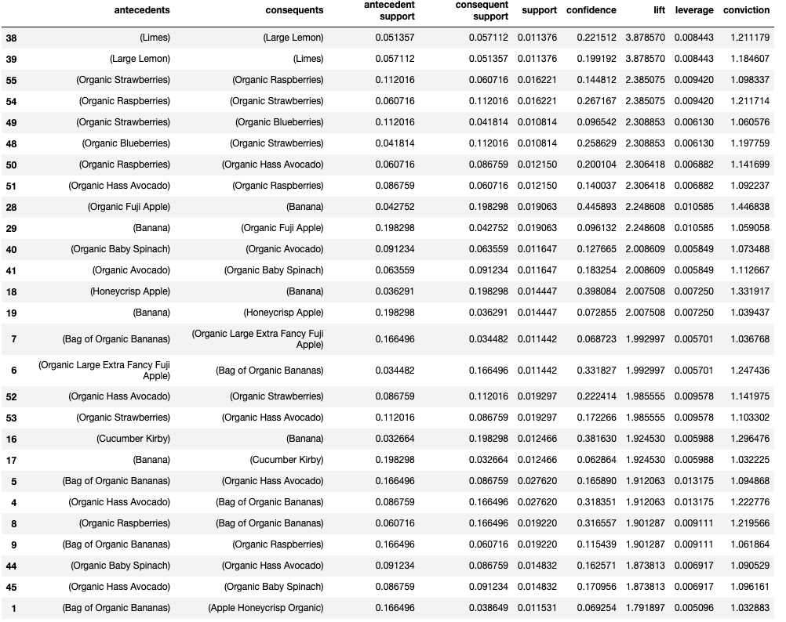
APPENDIX
Appendix I. Market Basket Analysis for Cluster 4

